Slide 1
KICKSTARTER
prediction
project

Slide 2
AGENDA
01
problem Description
02
General Analysis
03
Country & Category Analysis
04
Machine Learning
Building a predictive Model to understand predictors of project success and failure

Slide 3




GENERAL ANALYSIS
45K
90%
34 Days
60%
9K
Media Requested Amount
Projects are from US
Projects Failed
Median Pledged Amount
Days between project start and deadline

Slide 4
STATE ANALYSIS

Slide 5
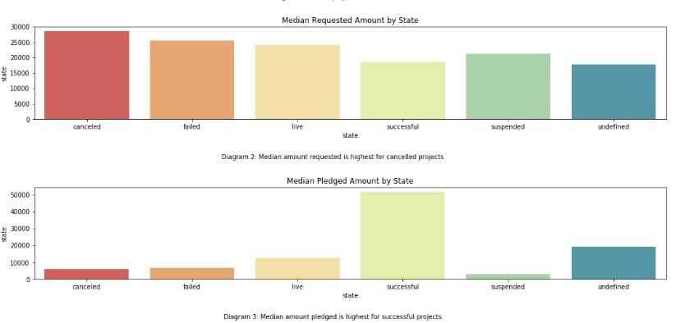
Median Pledged and Requested Amount Differs Across Project Outcome
STATE
Median Requested Amount and Pledged Amount Differ between different outcomes where successful projects tend to ask for less and get more pledged!

Slide 6
MAIN CATEGORY ANALYSIS

Slide 7
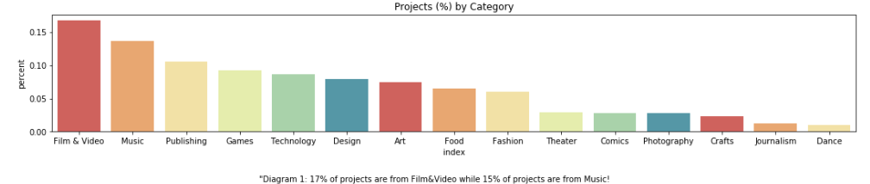
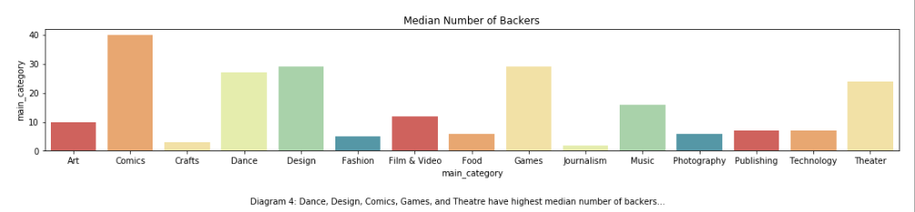
Film & Video – Most Common Categories
CATEGORIES
Film & Video (17%) projects are the most popular kind of projects while there are few projects for dance.
Technology projects do not seem to have as many backers compared to Comics, or Games Projects
Comics & Games, on average, have most backers

Slide 8
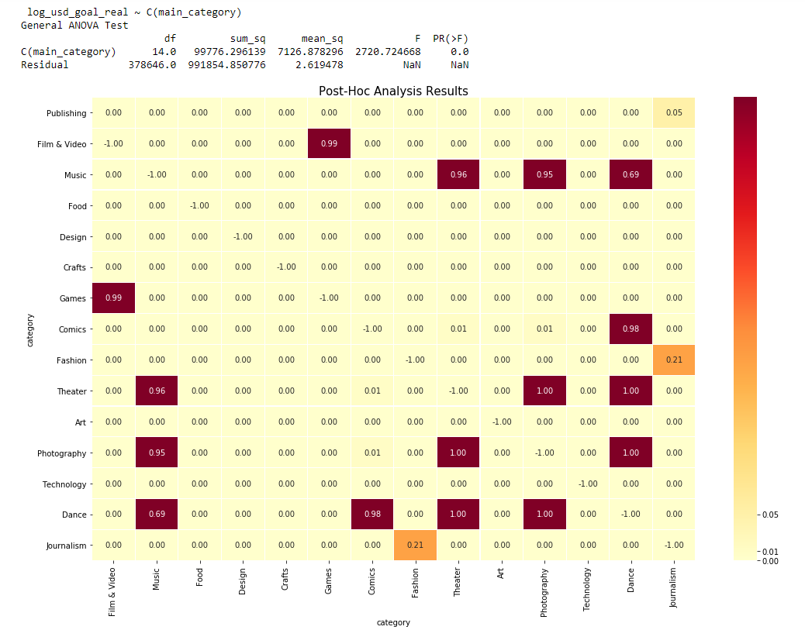
MEDIAN REQUESTED AMOUNT DIFFERS
ANOVA analysis confirmed that there is difference between mean requested amount
Post – hoc test showed that there are few categories where the mean amount isn’t significantly different

Slide 9
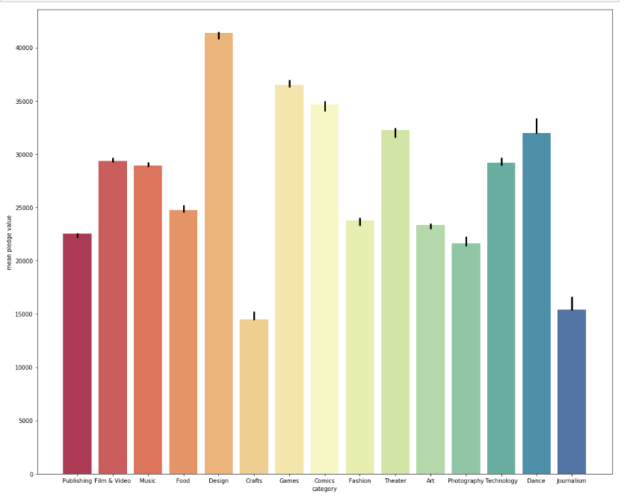
Confidence Interval for Each Category for Pledged Amount
Median Pledged Amount Highest - Design
As the pledged amount isn’t normally distributed, a bootstrap approach was utilized.
Confidence interval for Journalism, Dance, and Technology categories are wider indicating that the amount people pledge to those categories tends to vary more
Few of confidence intervals overlap indicating pledged amount is different across categories

Slide 10
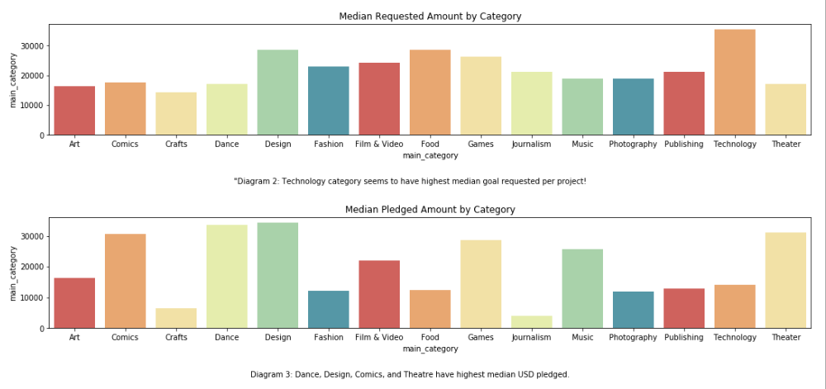
PLEDGED vs. REQESTED AMOUNT DIFFERS
Discrepancy between median pledged and median requested amount per category
Technology category projects on average tend to request more; but amount pledged is lower
Dance and Theatre projects have higher amounts pledged compared to amounts requested

Slide 11
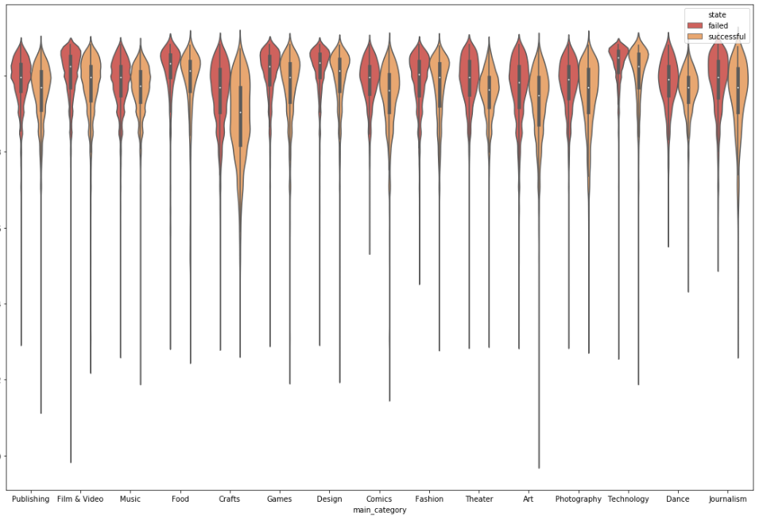
FAILED PROJECTS REQUEST MORE MONEY
The amount requested differs across
Technology Projects – amount requested on average is higher for failed projects.

Slide 12
KEY INSIGHTS
Failed Projects
Pledged vs. Requested Difference
Categories
Request More Money
Requesting higher amount for projects doesn’t automatically translate into higher amount pledged
Mean amount requested differs across each category
Games, Comic – have most backers on average
Tony Wilson
Designer
abcd@company.com
Facebook.com/abcd
Twiter.com/abcd

Slide 13
COUNTRY ANALYSIS

Slide 14
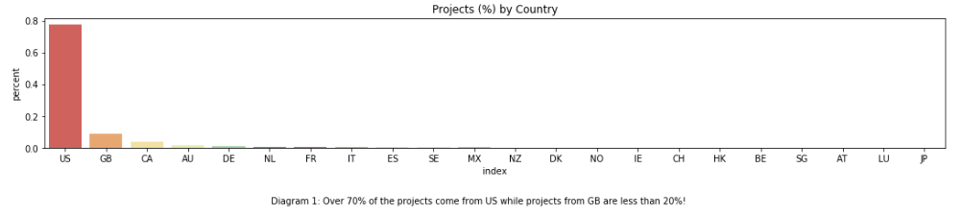
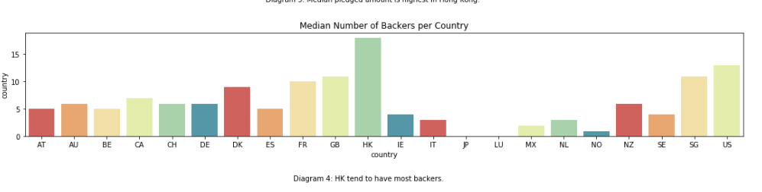
MOST OF PROJECTS COME FROM US
COUNTRIES
70% of all projects are from US
CAN & GB projects - also common
Yet, on average, the number of backers is more distributed across countries
US, HK, & SG HAVE MOST BACKERS

Slide 15
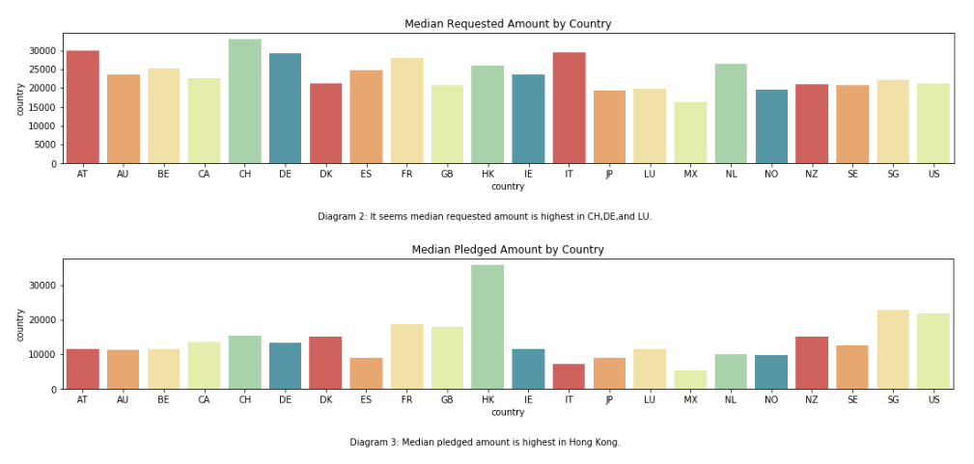
Highest Median Pledged Amount - HK
For most countries median requested amount is higher than median pledged except HK
HK median pledged is higher than median requested

Slide 16
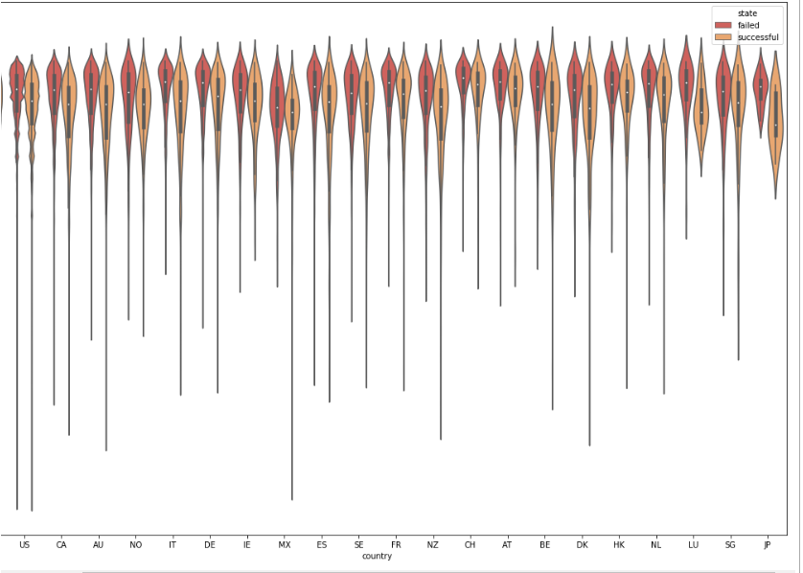
SUCCESSFUL PROJECTS - LOWER AMOUNT REQUESTED
Range of amount requested for successful projects is also wider indicating more uncertainty of what amount should be requested
Failed Projects more likely to go big and go home

Slide 17
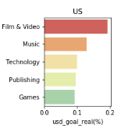
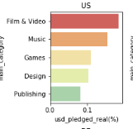
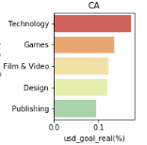
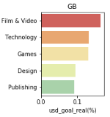
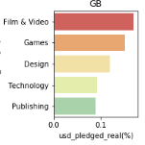
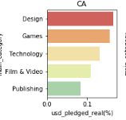
AMOUNT PLEDGED, REQUESTED DIFFERENT ACROSS COUNTRIES, CATEGORIES
Amount Requested
Text Here
Text Here
Canada: Most of the amount requested is for Technology projects while most of the money pledged is towards Design Projects
Similarly, Music projects have second most common based on amount requested but those type of projects don’t appear in amount pledged at all!
Amount Pledged
Text Here
Text Here

Slide 18
KEY INSIGHTS
Most Projects – from US
Most of Pledges –
HK
Successful Projects – Lower Amount Requested in Total and Per Day
USG, HK, & SG have highest number of backers on average
Tony Wilson
Designer
abcd@company.com
Facebook.com/abcd
Twiter.com/abcd

Slide 19
Project Length Analysis

Slide 20
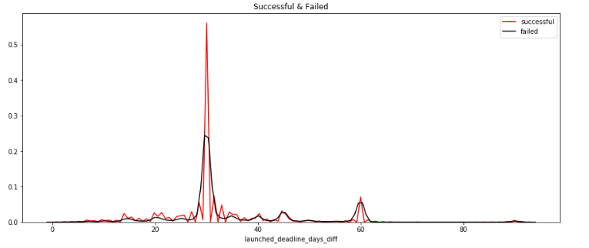
Failed – More Project Length Uncertainty
Over 50% of successful projects take 30 days between the time projects are announced and the end date. For failed projects, around 25% of projects take 30 days to complete, projects people are less certain about what timeline they should put for the project.

Slide 21
Summary
Amount requested and amount pledged varies by country and by category
Discrepancy between people creating new projects and having those projects actually generate interest from Kickstarter
Projects that fail tend to request more money compared to other projects

Slide 22
MACHINE LEARNING

Slide 23
Pre-model Variable Selection
Median Amount Pledged and Requested might be good predictors of project outcome
But using median amount pledged can lead to data leakage
Other factors such as country, main_category, project length tend to differ across median amount pledged and requested
In addition, title of the project will also be included

Slide 24
OBJECTIVE
Predict whether a Kickstarter project is success or failure
Objective
Name – the name of the project
Usd_goal_real, goal per day: amount requested, amount requested per day
Main Category, Category: category of project
Country: where the project started
Deadline month, Launched_month: month where project launched or finished
Predictors
State_num: binary variable where successful indicates the project has been successfully funded while
Dependent

Slide 25
Machine Learning Process
1
2
3
4
STEP
STEP
STEP
STEP
PREPROCESS
BASIC MODEL
HYPER PARAMETRIZATION
STACKING
Numerical Variables: Standard Scaler
Categorical Variables: One Hot Encoding
Text Extraction: Vectorizer
Apply Several Models and select the one that has highest accuracy rate
Models Used: Adaboost, Logistic Regression, XGB,SVC,SGDC
Hyper parametrize the model selected below to see if there are any meaningful gains in performance.
Apply ensemble model to learn whether there are any meaningful gains in performance .

Slide 26


Baseline Model Performs Best
Baseline Model
In the baseline model, SVG algorithm performed the best, followed by Logistic Regression. SVGD train accuracy was around 69 percent, while the test accuracy was the same
Test Accuracy
Using Hyper Parametrization.
69.5
Test
Accuracy
69.4%
Hyper Parametrized Model Delivers Few Benefits
Different values of l1_ratio,penalty, and alpha were evaluated. Final best model had alpha: 0.001, penalty: l2, and l1.ratio: 0.1. The model’s performance improved only slightly by 0.1 %

Slide 27
VARIABLE INFLUENCE
SUCCESSFUL
FAILED
Category and Text of Project Have greatest influence on project success failure
CATEGORY
Table Top Games: + 1.381
Theatre: + 1.017
Shorts: + 1.014
Classical Music: + .916
Anthologies: + .718
Camera Equipment: +. 714
Dance: + .669
Hip Hop: -.684
R&B: -1.036
CATEGORY: It shows projects related to Table Top Games, Theatre, Classical Music, or Dance have higher chance of being successful compared to Project related to Hip Hop, and R&B
TEXT: IF project text had residency, pens, watch, visual novel, or python in its text name, it had higher chance of succeeding compared to if it had manga or chess
Residency: + 1.134
Pens: + 1.046
Watches: + 1.004
Visual Novel: +0.963
Exhibition: +0.848
Python:+ 0.669
Manga: -0.693
Stage Play: -1.036
Chess: - 0.680
To Record: - 0.697
TEXT

Slide 28
Key Business Implications
Categories and the title of the project are important predictors to determine if project is success or not
Make data easily accessible to project creators to understand what chances they have of success
Utilize information from text analysis help project creators to write project titles that engage their readers
Provide information to project creators to understand mean amount requested

